Slide 1
Prediction of Neurological recovery after cardiac arrest
2024 INTERNATIONAL CONFERENCE ON
ADVANCES IN MODERN AGE TECHNOLOGIES FOR HEALTH AND ENGINEERING SCIENCES
Presenters:
Swapnil Makwana (swapnilmakwana4@gmail.com)
VL Jaganath Sai (vljaganathsai2003@gmail.com)
Sethu Madhav (sethumadhav2467@gmail.com)
Tatiparti Padma (profpadmat@gmail.com)

Slide 2
Table of Contents:
Introduction
Objectives
Existing Method
Limitations
Proposed Methodology
Dataflow
Simulation Results
Conclusion
Future Scope

Slide 3
Introduction
1.Cardiac arrest is a major concern in healthcare, often leading to uncertain neurological outcomes for survivors.
2. It is a leading cause of mortality worldwide, with survival rates varying depending on promptness of intervention and quality of care.
3. Neurological recovery post-cardiac arrest is a major concern for clinicians, as it can significantly impact patient quality of life and long-term outcomes.
4. Predicting neurological recovery accurately is crucial for guiding treatment strategies and optimizing patient care
5. Deep learning methodologies offer a promising avenue for improving the prediction of neurological recovery post-cardiac arrest.
6. By analyzing complex patterns and relationships within patient data, deep learning can potentially provide more accurate and reliable prognostic assessments.

Slide 4
Objectives
1.This project aims to develop and validate a precise predictive model for assessing neurological recovery after cardiac arrest.
2. The objectives include creating a comprehensive predictive tool using clinical, physiological, and neuroimaging data, ensuring its reliability through extensive testing, and providing a user-friendly resource for healthcare decision-making.
3. Provide Neurosurgeons with a reliable tool for diagnosing a patient with cardiac issues and make proper decisions from resource allocation and planning.
4. Document the entire process and disseminate findings to the scientific community through publications.
5. Ultimately, this endeavor contributes to advancing the field by offering an evidence-based approach to predicting post-cardiac arrest neurological recovery.

Slide 5
Existing approach
Implemented Bi-Lstm a typical Recurrent Neural Network model.
Trained the model based on bi directional dependencies of the patients EEG data obtained.
Existing approaches to predicting neurological recovery after cardiac arrest primarily rely on clinical assessments, neuroimaging, and electrophysiological tests.
These approaches incorporate factors such as the duration of cardiac arrest, initial rhythm, pupillary reflexes, and somatosensory-evoked potentials.
Classified 5 categorical outcomes into 2 classes.
Categorical classes are CPC scores (1,2,3,4,5) ,where 1,2 were classified as good outcome and 3,4,5 as bad outcomes
RoC-AuC levels achieved were 0.87 at the end of training and validation of input data

Slide 6
Limitations
1. The computational cost is very high for implementing above mentioned technique.
2. The methodology used is prone to overfitting as it tries to capture bidirectional dynamics from EEG data.
3. Obtained AUC-ROC scores were 0.85 .
4. Loss is high as compared to the necessity of the predictive accuracy.
5. Highly time consuming operation .

Slide 7
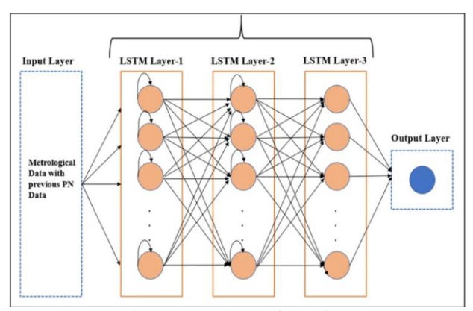
Proposed methodology
LSTM (Long short term memory) architecture is implemented by us.
Hyper parameter fine-tuning is performed on the parameters such as learning rate, number of epochs for training , the batch size for training data.
The architecture of neural network is designed by experimenting with various number of neurons for each layer of the model.
To improve the performance of the model by experimenting and aligning the theoretical knowledge.

Slide 8
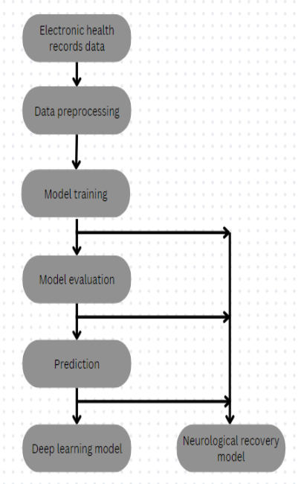
Data Flow
Loading the EEG dynamics data from the dataset.
Analysing the data for their correlation, null values and normalizing them.
Splitting the data points carefully for training testing and validating.
Design the architecture of Deep learning model using LSTM.
Batch the training data and start training the model and record the metrics for each epoch
Fine tune the parameters such as learning rate, batch size and number of epochs for training.
Finalize the model and put it to use for practitioners to extract valuable insights.

Slide 9
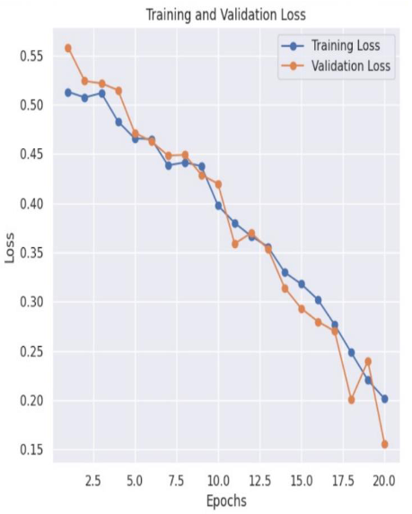
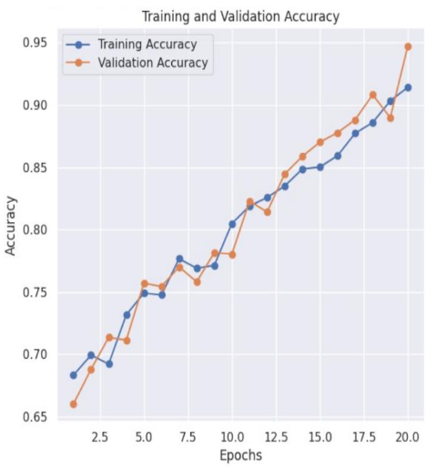
Simulation Results

Slide 10
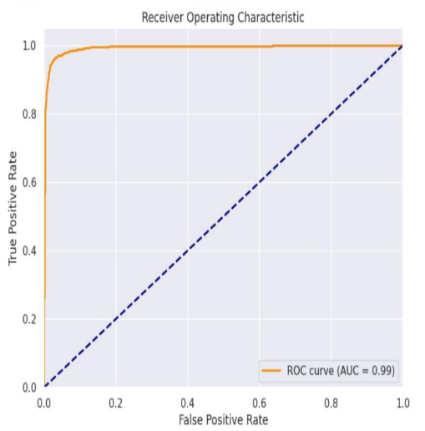
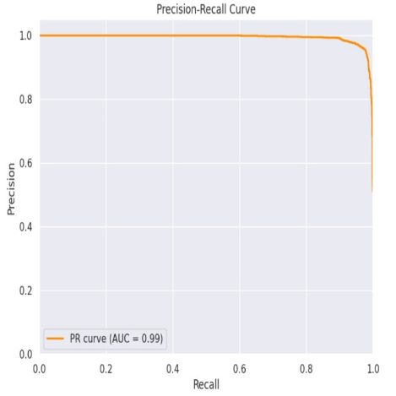
Simulation Results

Slide 11
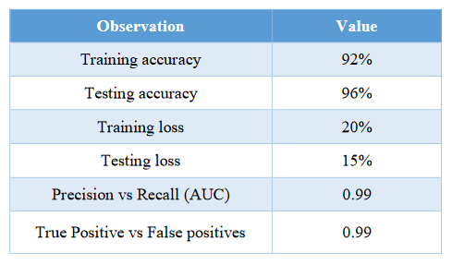
Simulation Results

Slide 12
Conclusion
1.The deep learning model demonstrated remarkable accuracy in categorizing patients based on their likelihood of neurological recovery post-cardiac arrest.
2. Evaluation metrics, including sensitivity, specificity, and PR Curve (AuC) of 0.99, underscored the model's proficiency in prognosticating neurological recovery.
3. The model's analysis provided crucial insights into influential factors driving predictive outcomes, highlighting the significance of specific pre-hospital and post-resuscitation variables.
4. It exhibited strong performance in differentiating between varying degrees of neurological outcomes, effectively classifying patients into binary classes of good and bad outcomes.
5. The results highlight the importance of integrating advanced computational methods into clinical practice for personalized patient care.

Slide 13
Future Scope
Implementing various data augmentation techniques can further enhance the model's predictive capabilities and robustness.
Making the data easily trainable by machine learning models and emerging predictive tools can improve the efficiency and accuracy of predictions.
Exploring additional features and variables related to pre-hospital interventions and post-resuscitation care could provide deeper insights into neurological recovery prediction.
Incorporating patient-specific data, such as genetic markers or comorbidities, could enhance the model's ability to provide personalized prognostic assessments.
Exploring the potential integration of the model with clinical decision support systems could streamline treatment planning and improve patient care.
Our study on predicting neurological recovery after cardiac arrest using deep learning LSTM lays a robust foundation for future research in this critical area. We believe that our work will offer valuable insights and pave the way for further advancements in predicting outcomes for individuals who have experienced cardiac arrest.

Slide 14
THANK YOU!!

